Slide 1

Deploying Java Applications
A comprehensive guide to building, deploying, and monitoring Java applications in production environments

Slide 2
Understanding the Deployment Workflow
The deployment process transforms your Java application from source code into a running production system. This workflow encompasses several critical stages that ensure your application is built correctly, tested thoroughly, and deployed reliably.
01
Source Code Management
Modern deployment practices emphasise automation, consistency, and repeatability. By understanding each stage of the workflow, development teams can identify bottlenecks, reduce deployment failures, and accelerate time-to-market.
Version control and branching strategies
02
Build & Test
Compilation and automated testing
03
Artefact Creation
Packaging application components
04
Deployment
Release to target environments
05
Monitoring
Tracking application health

Slide 3

Continuous Integration and Continuous Deployment
CI/CD pipelines automate the software delivery process, enabling teams to release high-quality applications faster and more reliably. These pipelines orchestrate building, testing, and deployment activities triggered by code changes.
Jenkins Pipeline
Declarative and scripted pipeline syntax
Extensive plugin ecosystem for Java tools
Distributed build architecture with agents
Integration with Maven, Gradle, and JUnit
GitHub Actions
YAML-based workflow configuration
Native integration with GitHub repositories
Matrix builds for multiple Java versions
Marketplace with pre-built actions

Slide 4
Setting Up Jenkins CI/CD Pipeline
Key Configuration Steps
Sample Jenkinsfile Structure
1
Install Jenkins
pipeline { agent any tools { maven 'Maven 3.8.6' jdk 'JDK 17' } stages { stage('Checkout') { steps { git branch: 'main', url: 'repository-url' } } stage('Build') { steps { sh 'mvn clean compile' } } stage('Test') { steps { sh 'mvn test' } } stage('Package') { steps { sh 'mvn package' } } stage('Deploy') { steps { // Deployment commands } } } }
Deploy on server or container
2
Configure JDK & Maven
Set up Java build tools
3
Create Pipeline Job
Define Jenkinsfile with stages
4
Add SCM Integration
Connect to Git repository
5
Configure Webhooks
Enable automatic triggering

Slide 5
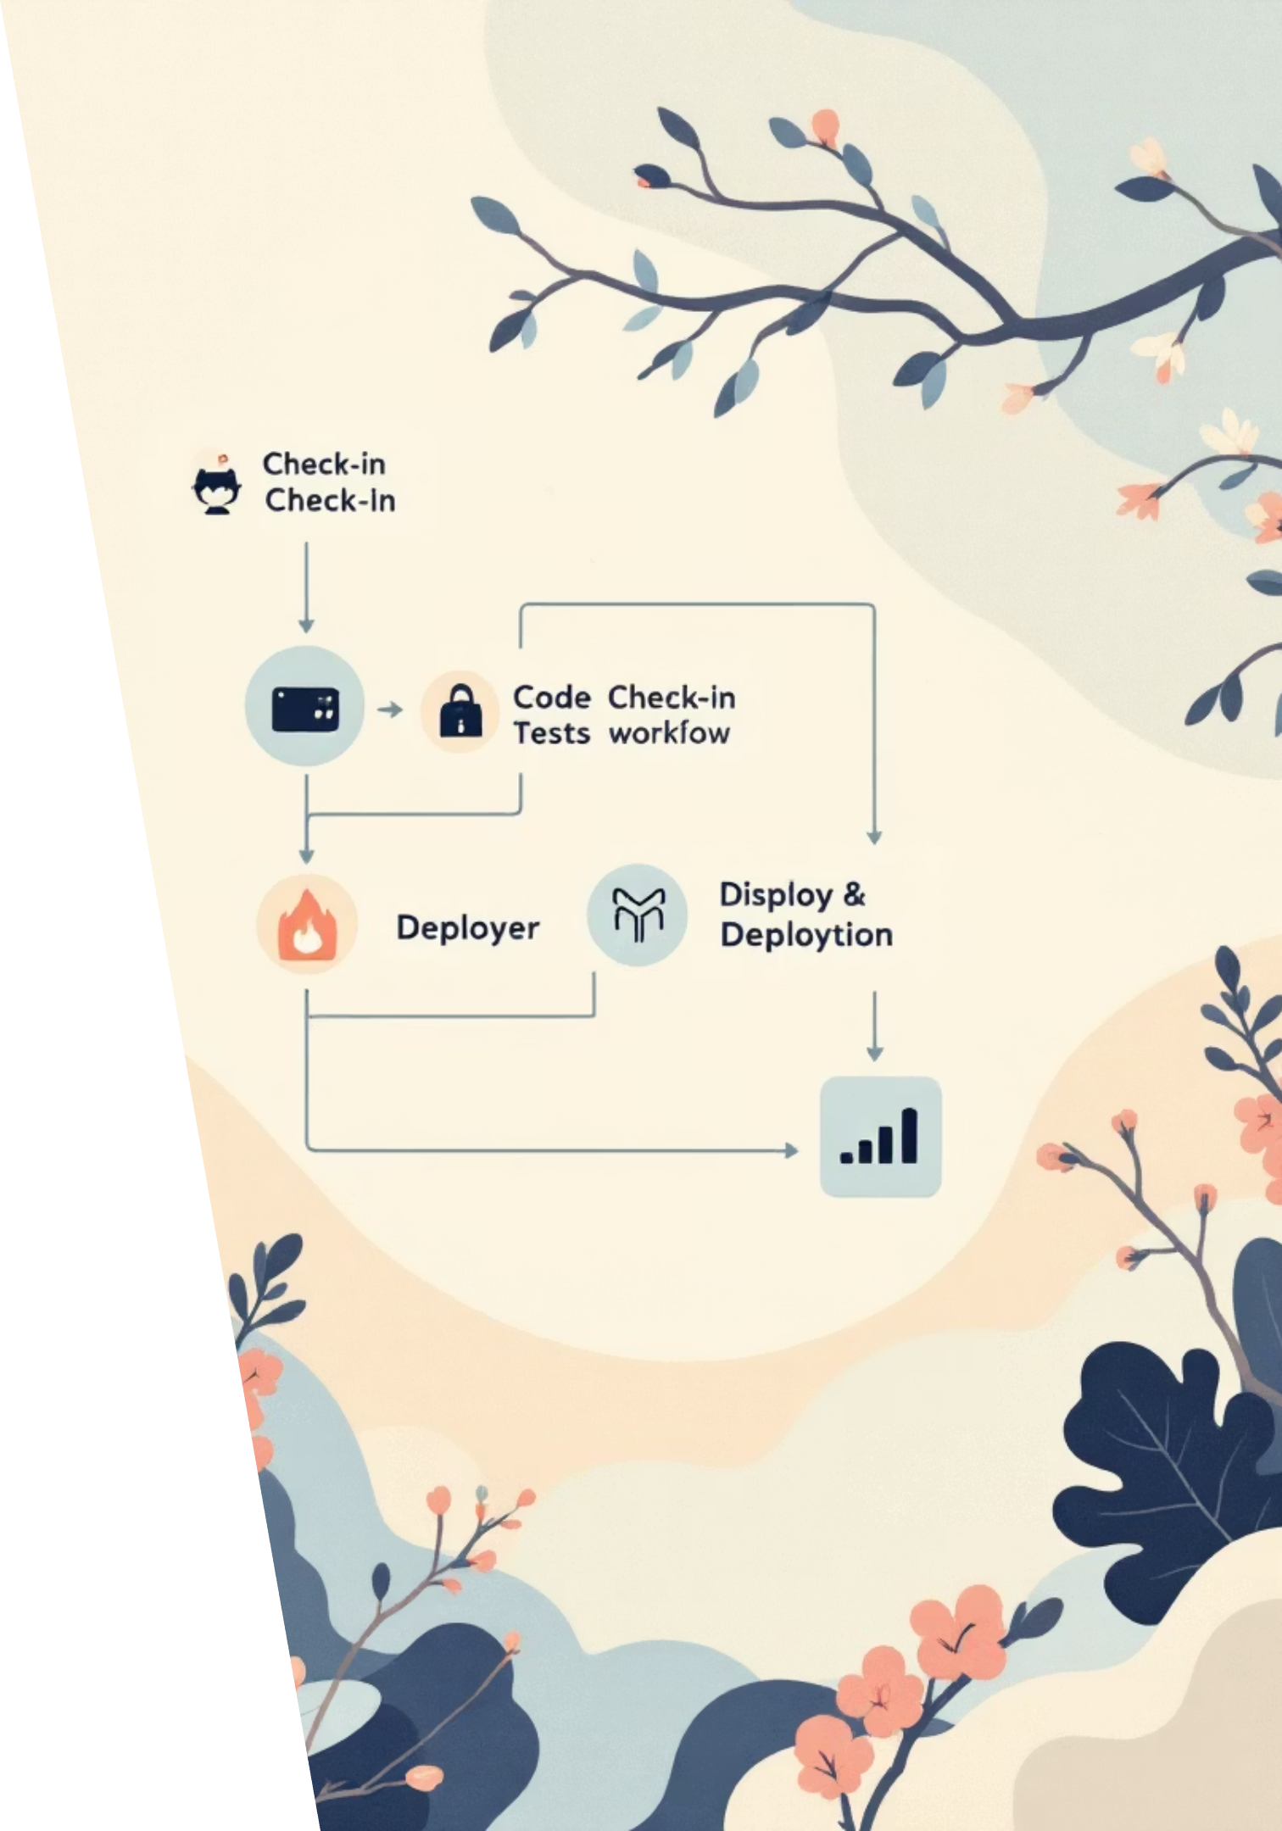
GitHub Actions Workflow Configuration
GitHub Actions provides cloud-based CI/CD directly integrated with your repository. Workflows are defined using YAML files in the .github/workflows directory.
Workflow Triggers
1
Define events that initiate pipeline execution: push, pull requests, scheduled runs, or manual dispatch
Job Configuration
2
Specify runner environment, checkout code, setup Java using actions/setup-java, and define build matrix
Build & Test Steps
3
Execute Maven or Gradle commands, run unit and integration tests, generate coverage reports
4
Artefact Publishing
Upload build artefacts, publish to package registries, create release distributions

Slide 6

Building and Packaging Java Applications
Build Tools Overview
Common Packaging Formats
Java applications require compilation, dependency resolution, and packaging into deployable formats. Build automation tools streamline these processes and ensure consistency across environments.
JAR Files
Standard Java archive for libraries and standalone applications
Apache Maven
WAR Files
Convention-over-configuration approach
Web application archive for servlet containers like Tomcat
XML-based project object model (POM)
Extensive plugin ecosystem
Dependency management via repositories
Docker Images
Standard lifecycle phases
Containerised application with all dependencies included
Gradle Build Tool
Groovy or Kotlin DSL configuration
Incremental builds for performance
Flexible and highly customisable
Multi-project build support
Rich task dependency graph

Slide 7




Deploying to Cloud Platforms
Cloud platforms provide scalable infrastructure for hosting Java applications. Deployment strategies vary based on application architecture, scalability requirements, and operational preferences.
Amazon Web Services
Microsoft Azure
EC2: Virtual machines with full control
Virtual Machines: IaaS compute resources
Elastic Beanstalk: Platform-as-a-service for Java
App Service: Fully managed platform
AKS: Kubernetes service
ECS/EKS: Container orchestration services
Functions: Event-driven compute
Lambda: Serverless function execution
Google Cloud Platform
Compute Engine: Customisable VMs
App Engine: Managed application platform
GKE: Enterprise Kubernetes
Cloud Run: Serverless containers

Slide 8
Container Deployment with Docker and Kubernetes
Docker Containerisation
Kubernetes Orchestration
Docker packages Java applications with their runtime environment, ensuring consistency across development, testing, and production. Containers are lightweight, portable, and isolated.
Kubernetes manages containerised applications at scale, providing automated deployment, scaling, and operations. It's the industry standard for container orchestration.
Core Kubernetes Resources:
Essential Dockerfile Components:
Deployments: Declarative application updates
Base image selection (OpenJDK, Eclipse Temurin)
Services: Network access and load balancing
Application artefact copying
ConfigMaps: External configuration management
Dependency installation and configuration
Secrets: Sensitive data handling
Environment variable definition
Ingress: HTTP/HTTPS routing
Exposed ports and entry point commands
Persistent Volumes: Stateful data storage
Multi-stage builds for optimised image size

Slide 9



Monitoring with Prometheus and Grafana
Effective monitoring ensures application health, performance, and reliability. Prometheus collects metrics whilst Grafana provides powerful visualisation and alerting capabilities.
Prometheus Metrics Collection
Grafana Visualisation
Alerting & Response
Time-series database that scrapes metrics from instrumented applications via HTTP endpoints. Supports multidimensional data model with powerful query language (PromQL).
Creates interactive dashboards displaying application metrics, system performance, and business KPIs. Supports alerting rules with multiple notification channels.
Configure threshold-based alerts for critical metrics. Integrate with PagerDuty, Slack, or email for incident notification and response coordination.
Key Metrics to Monitor
Application Metrics
JVM Metrics
Infrastructure Metrics
Request rate and latency
Heap memory utilisation
CPU and memory usage
Error rates by endpoint
Garbage collection duration
Network throughput
Active database connections
Thread pool statistics
Disk I/O operations

Slide 10
Centralised Logging with ELK Stack
The ELK Stack (Elasticsearch, Logstash, Kibana) provides comprehensive log management, enabling developers and operations teams to search, analyse, and visualise application logs from multiple sources.
Logstash: Log Ingestion
Kibana: Visualisation
Collects, parses, and transforms log data from various sources. Supports numerous input plugins for files, syslog, and message queues. Filters structure unformatted logs into searchable fields.
Web interface for exploring and visualising log data. Create custom dashboards, search queries, and visualisations. Set up alerts based on log patterns or anomalies detected in data.
1
2
3
Elasticsearch: Storage & Search
Distributed search and analytics engine storing log data. Provides full-text search capabilities with near real-time indexing. Scales horizontally across multiple nodes for high availability.
Best Practices for Log Management
Use structured logging formats (JSON) for easier parsing
Set up log retention policies to manage storage costs
Include correlation IDs for distributed tracing
Create index lifecycle management rules in Elasticsearch
Implement appropriate log levels (DEBUG, INFO, WARN, ERROR)
Configure log aggregation at the application layer
Avoid logging sensitive information like passwords or tokens
Establish alerting rules for critical error patterns

